Slide 2
Carter Bell
“Jesus wept.”
(John 11:35)

Slide 3
Hailey Boelk
“And now these three remain: faith, hope, and love. But the greatest of these is love.”
(1 Corinthians 13:13)

Slide 4
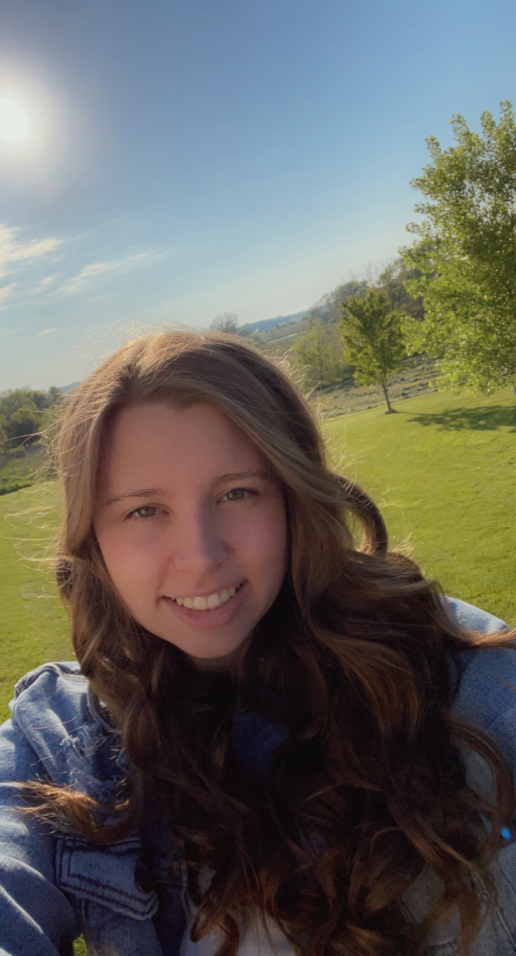
Alexandria Fauska “Trust in the Lord with all your heart, and do not lean on your own understanding. In all your ways acknowledge him, and he will make straight your paths.” (Proverbs 3:5-6)

Slide 5
Katelyn Kissinger
“Be kind to one another, tenderhearted, forgiving one another, as God in Christ forgave you.”
(Galatians 6:9-10)

Slide 6
Marissa Kottke
“My Command is this: Love each other as I have loved you. Greater love has no one than this: to lay down one’s life for one’s friend.”
(John 15: 12-13)

Slide 7
Sharleah Sabel
“I can do all things through him who strengthens me.” (Philippians 4:13)

Slide 8
Emily Schwalbach
"Have I not commanded you? Be strong and courageous. Do not be afraid; do not be discouraged, for the Lord your God will be with you wherever you go.“
(Joshua 1:9)

Slide 9
Congratulations!

